Slide 1
Inheritance

Slide 2
Inheritance
Inheritance enables you to define a new class based on a class that already exists.
The new class will inherit the characteristics of the existing class, but may also provide some additional capabilities.

Slide 3
Inheritance
Person
superclass
Student
subclass
The class that is used as a basis for defining a new class is called a superclass (or parent class or base class).
The new class based on the superclass is called a subclass (or child class or derived class.)

Slide 4
Inheritance
Inheritance is between classes, not between objects. A superclass is a blueprint that is followed when a new object is constructed.

Slide 5
Inheritance
That newly constructed object is another blueprint that looks much like the original, but with added features.
The subclass in turn can be used to construct objects that look like the superclass’s objects, but with additional capabilities.

Slide 6
Inheritance
Student
Albert Einstein
High School Student
Lynne Brooke
Monty Vista

Slide 7
Class Hierarchies

Slide 8
Class Hierarchies
In a hierarchy, each class has at most one superclass, but might have several subclasses.
There is one class, at the top of the hierarchy, the root of the hierarchy, that has no superclass.

Slide 9
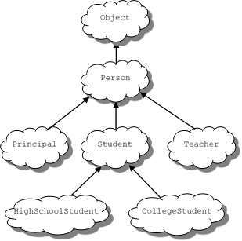
Hierarchy

Slide 10
Class Hierarchy - Syntax
In Java, the syntax for deriving a child class from a parent class is:
class subclass extends superclass{
//new characteristics of the subclass go here
}

Slide 11
Using Inheritance

Slide 12
Lesson Handout
The Student class is a derived class (subclass) of Person.
An object of type Student contains myIdNum and myGPA, which are defined in Student.

Slide 13
Lesson Handout
The Student class also has indirect access to the private variables myName, myAge, and myGender from Person through the methods:
getName()
getAge()
getGender()
setName()
setAge()
setGender()
that it inherits from Person.

Slide 14
Student Class
The constructor for the Student class initializes the instance data of Student objects and uses the Person class’s constructor to initialize the data of the Person superclass.

Slide 15
Student Class
The statement super(name, age, gender) invokes the Person class’s constructor to initialize the inherited data in the superclass.
The next two statements initialize the members that only Student has.
Note: when super is used in a constructor, it must be the first statement.

Slide 16
Access Modifiers
public - class members that can be accessed outside the class
private - class members that are inaccessible from outside the class
protected - class members can be used in the class in which it is defined and in any subclass of that class

Slide 17
Method Overriding

Slide 18
Method Overriding
A derived class can override a method from its base class by defining a replacement method with the same signature.

Slide 19
Method Overriding
For example, in our Student subclass, the toString() method contained in the Person superclass does not reference the new variables that have been added to objects of type Student, so nothing new is printed out.

Slide 20
Method Overriding
We need a new toString() method in the class Student:
// overrides the toString method in the parent class
public String toString(){
return getName() + ", age: " + getAge() + ", gender: "
+ getGender() + ", student id: " + myIdNum
+ ", gpa: " + myGPA;
}

Slide 21
Method Overriding
A more efficient alternative is to use super to invoke the toString() method from the parent class
public String toString(){
return super.toString() + ",student id:"
+ myIdNum + ", gpa: " + myGPA;
}

Slide 22
Interfaces

Slide 23
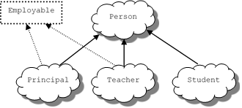
Interfaces

Slide 24
Interfaces - Definition
In Java, an interface consists of a set of methods and/or methods, without any associated implementations.
Here is an example of Java interface that defines the behaviors of “employability” :
public interface Employable{
public double getSalary();
public String getEmployeeID();
public void setSalary(double salary);
public void setEmployeeID(String id);
}

Slide 25
Interfaces - Syntax
A class can implement any number of interfaces.
So, we can have things like (assuming we have an interface named Californian)
public class Teacher extends Person implements Employable, Californian{
...
}

Slide 26
Interfaces
Interfaces are useful for the following:
Declaring a common set of methods that one or more classes are required to implement
Providing access to an object's programming interface without revealing the details of its class.
Providing a relationship between dissimilar classes without imposing an unnatural class relationship.

